Slide 1

Netflix Data Analysis
Devdipro Bhaduri
INTERNSHIP_17546440516895be537820f
APPLY_175593885768a98029dbfc9

Slide 2

PROBLEM STATEMENT
Major Project Proposal: Netflix Dataset Analysis
1. Introduction to Dataset The dataset under consideration is a Netflix dataset containing 7,789 records and 11 columns. It includes important details about Movies and TV Shows available on the platform. Key attributes include the title, director, cast, country of origin, release date, rating, duration, and type (genres). The dataset spans multiple years, with entries ranging from 2008 to 2021, covering content across diverse countries and genres.
2. Problem Statement Netflix has become one of the most prominent global streaming platforms, continuously expanding its library with a mix of original productions and licensed content. However, with growing competition from platforms like Amazon Prime, Disney+, and regional OTT providers, Netflix must strategically analyze its content catalog to identify strengths, gaps, and opportunities. The specific problem to be addressed in this project is 'Content Trends Analysis for Strategic Recommendations'. The aim is to uncover how Netflix’s content distribution (Movies vs. TV Shows, genres, and country contributions) has evolved over the years. This will enable the identification of key genres, audience preferences, and strategic insights into global content expansion.
3. Importance of the Problem Statement Understanding Netflix’s content trends is crucial for making data-driven business decisions. The analysis not only highlights the balance between Movies and TV Shows but also reveals popular genres and underrepresented categories. For a platform that serves diverse international audiences, country-wise contributions provide valuable insights into global representation and market penetration. By focusing on these content trends, Netflix can refine its strategy for content acquisition and production, ensuring that it caters to the right audience segments while staying competitive in the global OTT industry.
4. Objectives - Analyze the distribution of Movies vs. TV Shows over the years. - Identify the most common genres and how their popularity has changed. - Compare country-wise contributions to Netflix’s catalog.
5. Expected Outcomes - - A clear understanding of how Netflix’s content strategy has evolved. Identification of top-performing genres and categories. - Strategic recommendations on which content types Netflix should focus on in the future.

Slide 3
Project Description
Description:
This research is an extensive examination of the Netflix library consisting of 7,789 movies and television shows from different times and countries.
The examination reveals distribution of content type (i.e., movies vs television), aggregate genre usage, and contribution by country, and provides general recommendations related to content creation, licensing, and engaging audiences.
Key Objectives:
To understand longitudinal comparisons of movies and TV shows.
To examine which genres are key genres and how genres change over time.
To examine the number of movies and television show that represent Netflix's global catalog by country.
To provide fact-based information for decision-making regarding streaming video content.
Next Steps:
Creating a detailed business intelligence report that summaries trends in Netflix's content, attributes, and strategic recommendations for enhancing contests's competitive advantages.

Slide 4

WHO ARE THE END USERS?
Primary End Users -
Netflix Content Strategy Team – Identify underrepresented genres and plan future acquisitions.
Business Intelligence & Analytics Division – Automate trend reports and build predictive dashboards.
Regional Marketing Teams – Target audiences based on regional content performance.
Product & Recommendation System Engineers – Use enriched metadata to improve recommendation accuracy.
Executive Leadership & Investors – Access summarized dashboards for strategic decision-making.
Impact: Empowers Netflix to make data-driven strategic decisions on content acquisition, diversification, and production investments.

Slide 5

Technology Used
Language: Python 3
IDE: Jupyter Notebook (VSCode)
Libraries: pandas, numpy, matplotlib, seaborn, scipy
Data Cleaning & Transformation: pandas
Statistical Analysis: IQR & Z-score outlier detection (scipy)
Visualization: matplotlib, seaborn
Version Control: Git & GitHub
Documentation & Reporting: Markdown, ReportLab, ChatGPT
Presentation: Microsoft PowerPoint

Slide 6
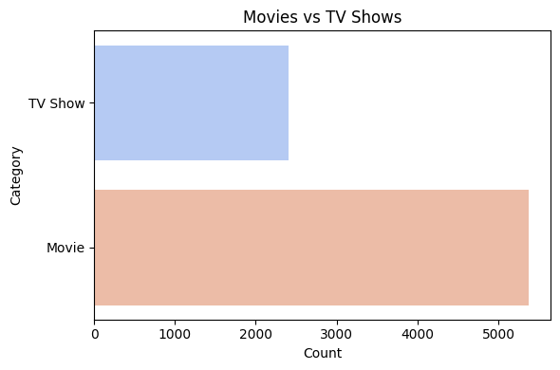
RESULTS1

Slide 7
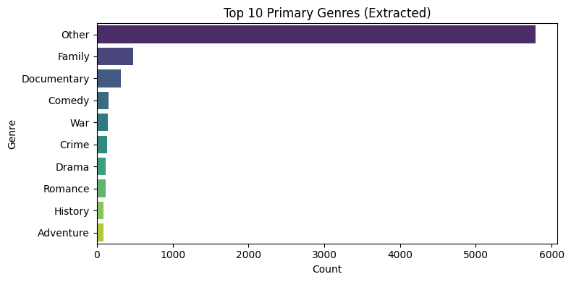
RESULTS2

Slide 8
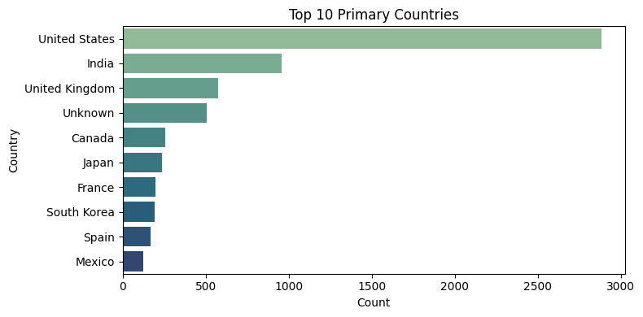
RESULTS3

Slide 9
GitHub repository
https://github.com/DesmondKarakara/VOIS_AICTE_Oct2025_DevdiproBhaduri_MajorProject

Slide 10

Getting started with Basics of Python Certificate

Slide 11
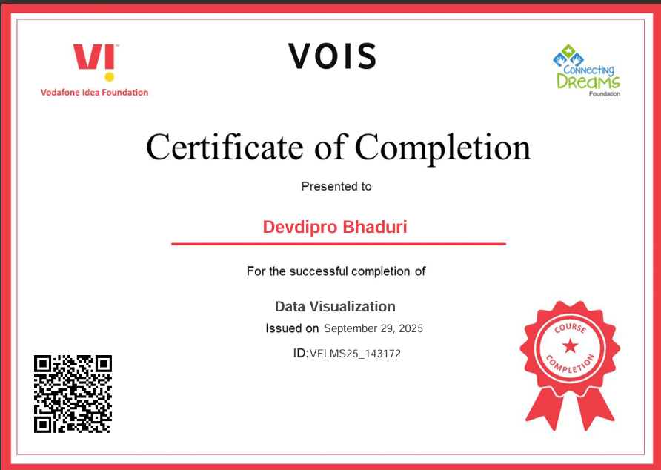
Data Visualization Certificate

Slide 12
Thank You
.
.

